Slide 1
INSTALLATIONS
For Software Engineering Lab
OS- Windows 10 pro

Slide 2
REQUIRED SOFTWARE'S
1. Install Git Bash for Windows
2. Create an account on GitHub
https://github.com/
3. Install JDK 11 and set Environmental variables (YouTube link attached)
https://www.youtube.com/watch?v=1ZbHHLobt8A
4. Install Maven and set Environmental variables
5. Install Eclipse IDE (YouTube link shared)
https://www.youtube.com/watch?v=N-wXTRpR03U

Slide 3
REQUIRED SOFTWARE'S
6. Install Tomcat
7. Configure Tomcat to Eclipse

Slide 4
GIT INSTALLATION

Slide 5
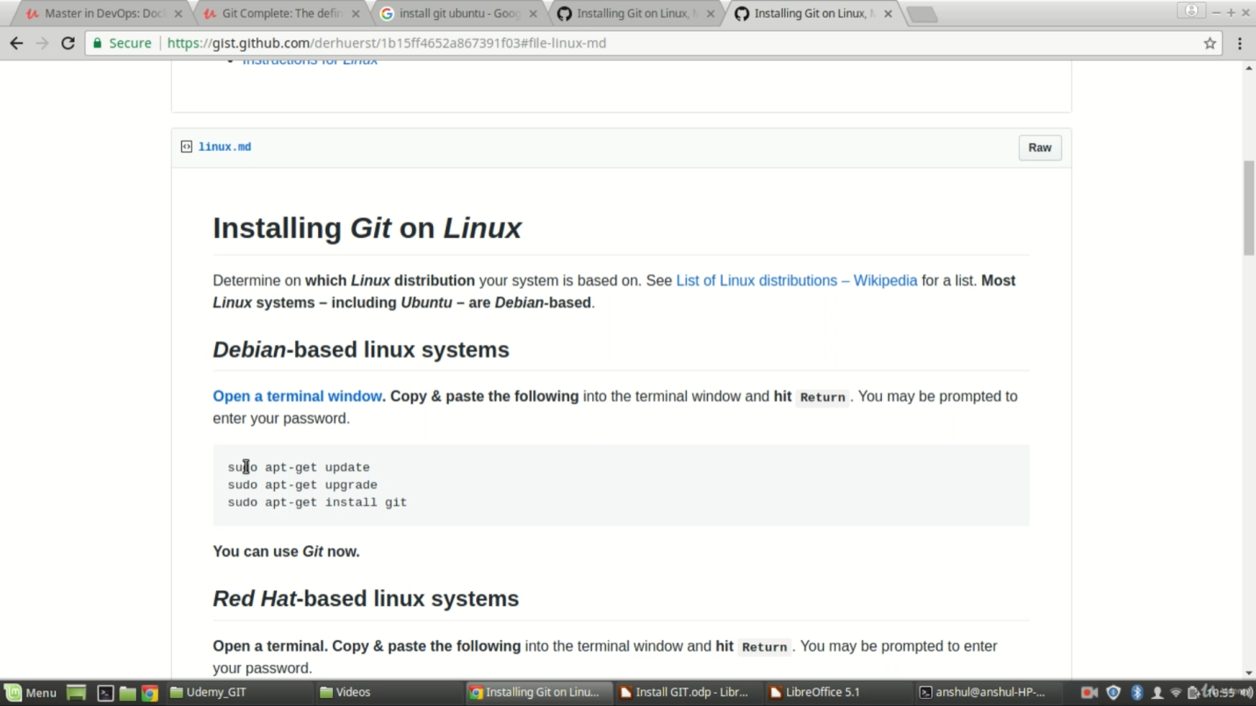
INSTALLING GIT IN LINUX
We can download and install Git from the above website for Linux environment

Slide 6
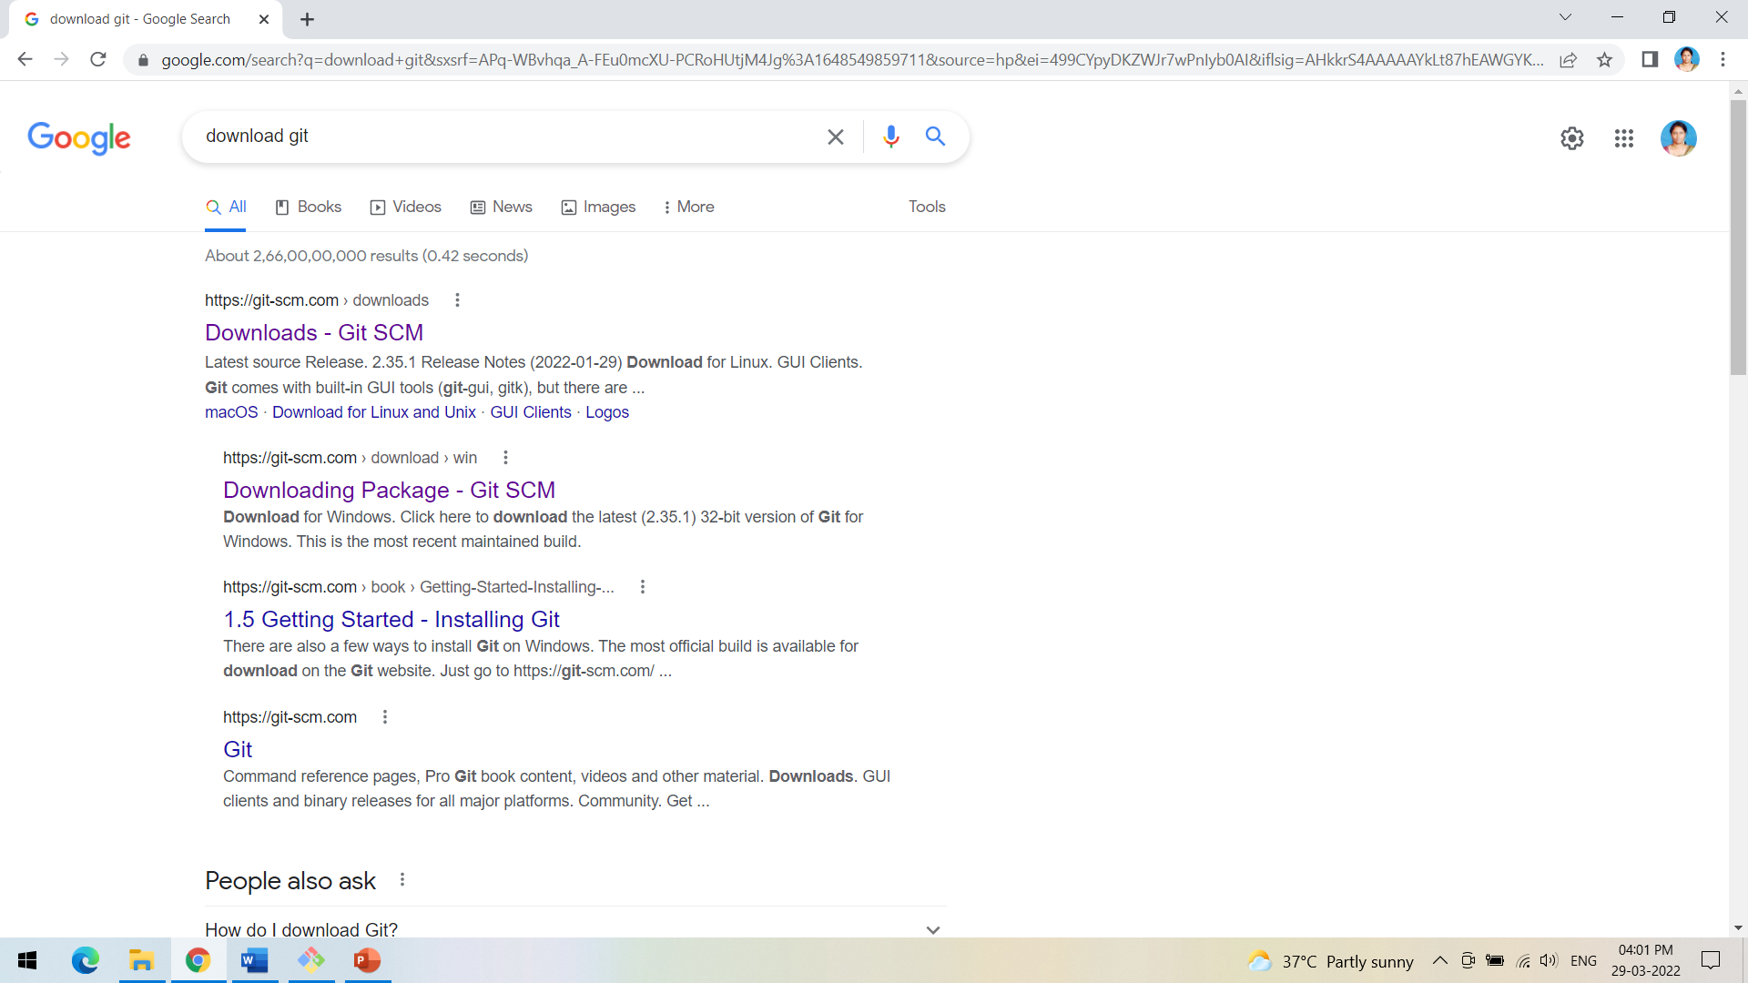
INSTALLING GIT IN WINDOWS
We can type download git from google.com and click on the first link Git SCM

Slide 7
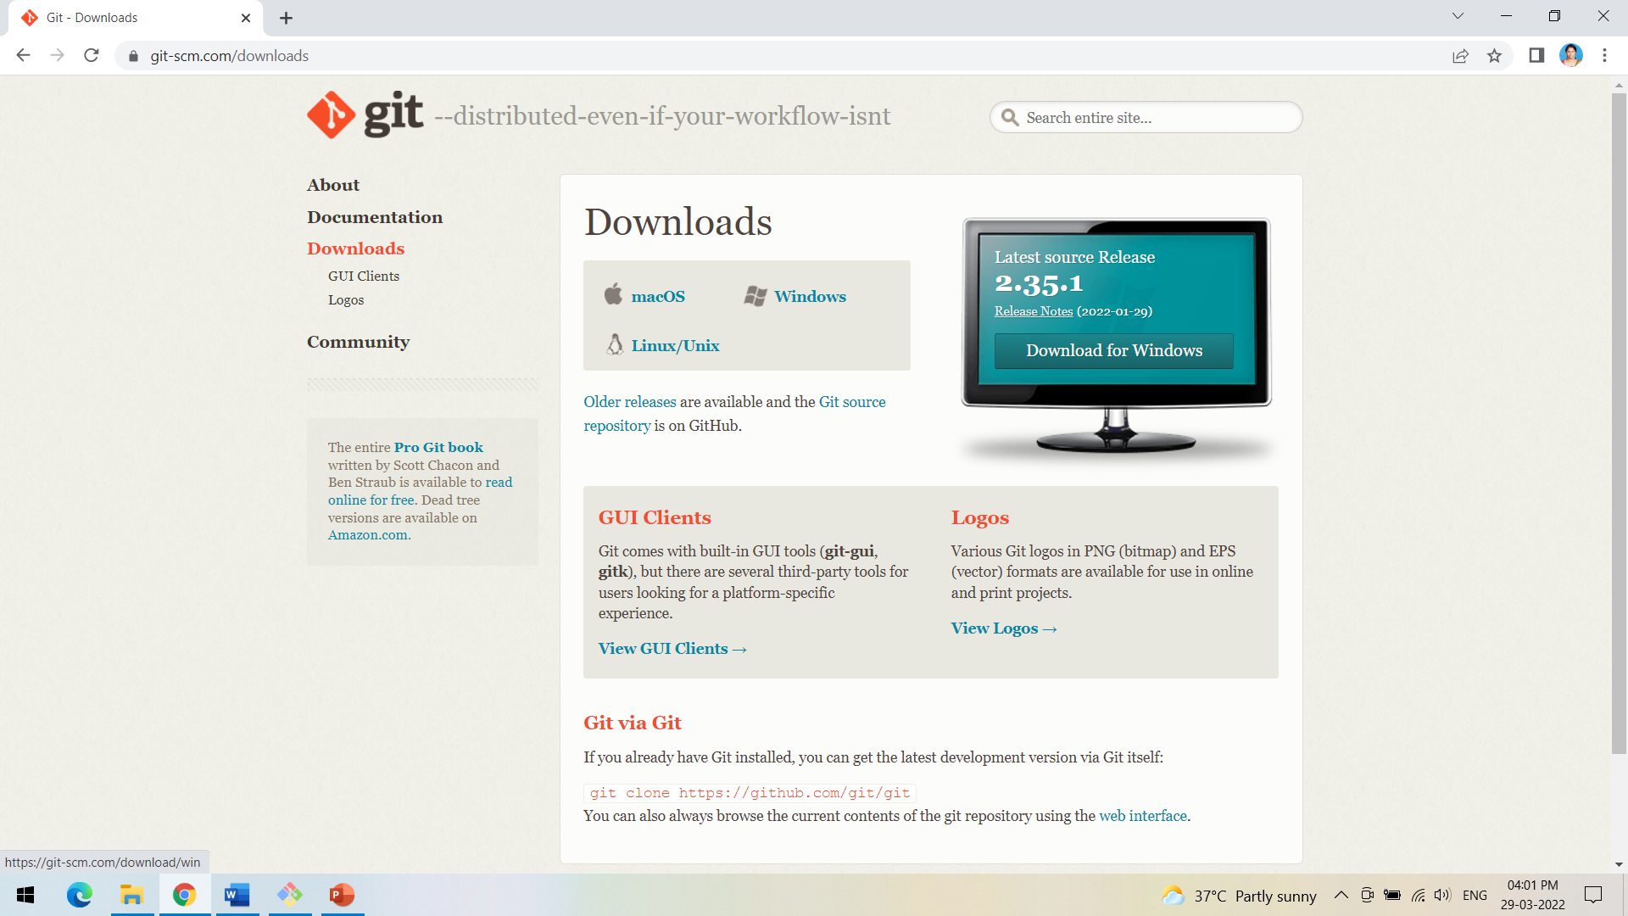
INSTALLING GIT IN WINDOWS
Select the Git software for the required OS.

Slide 8
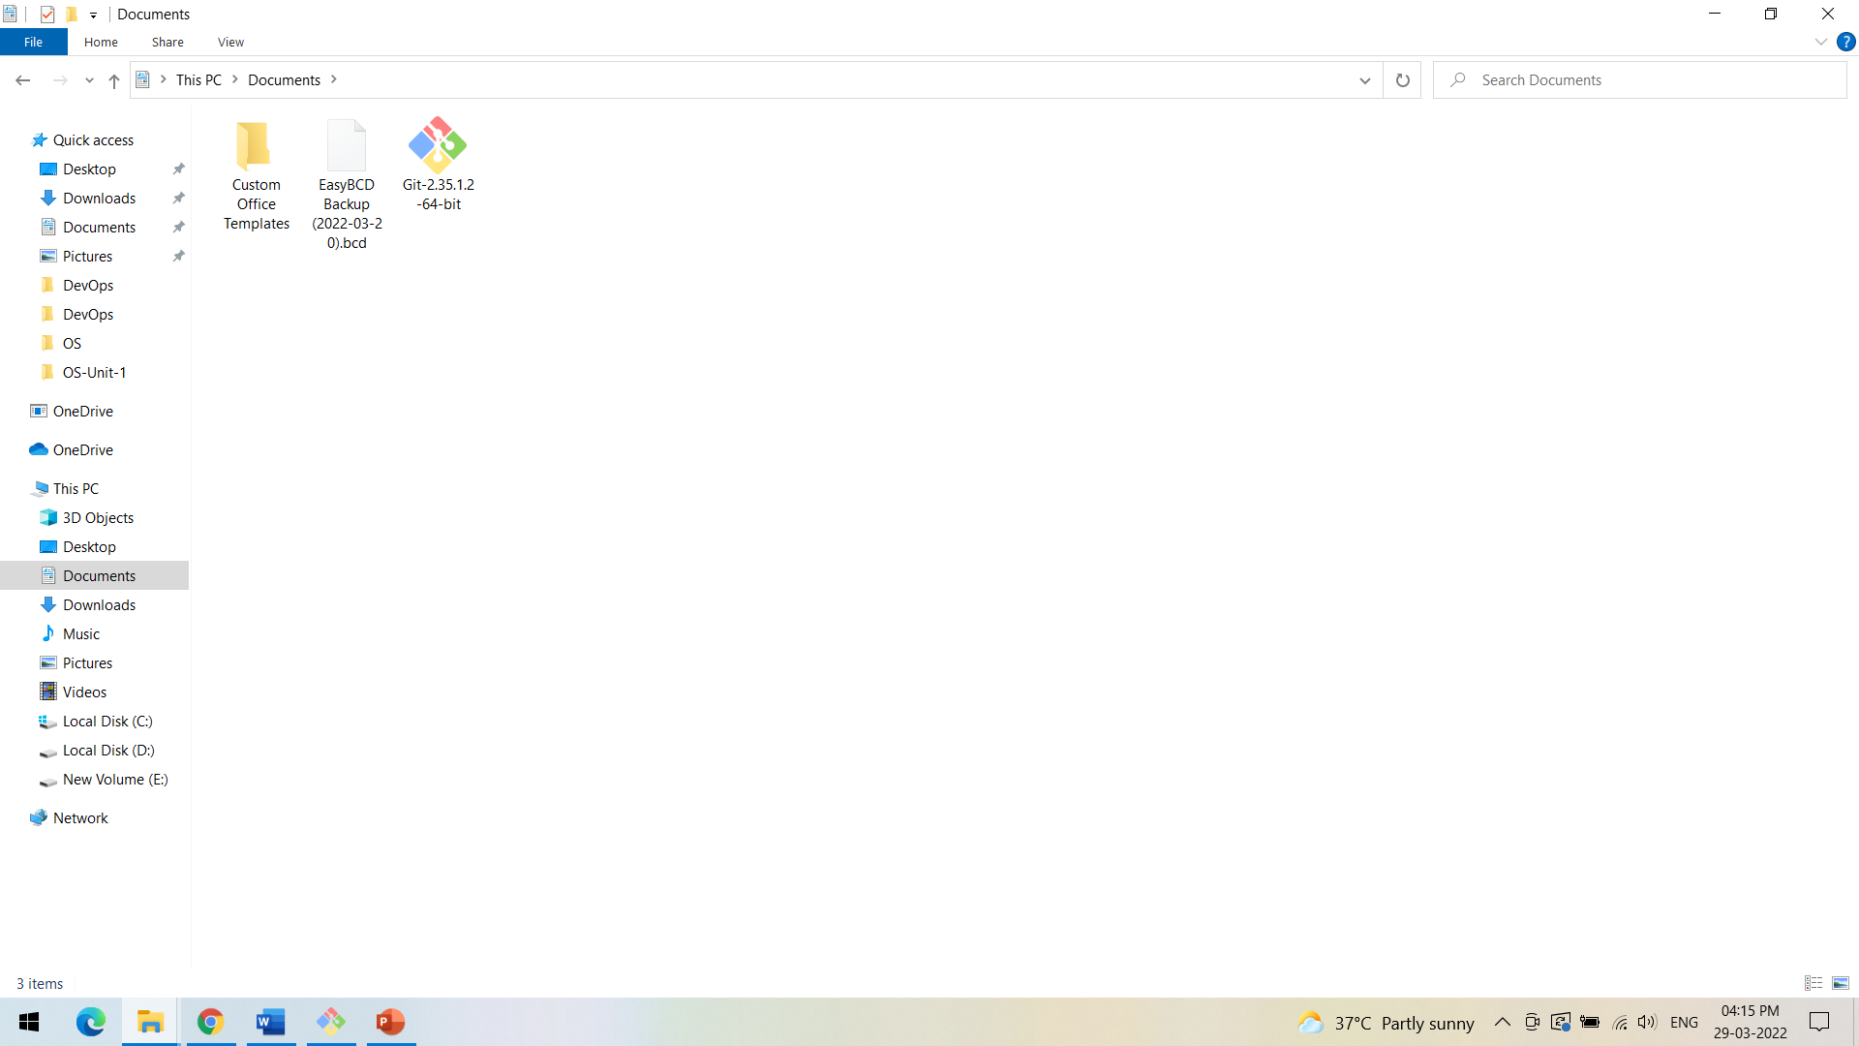
INSTALLING GIT IN WINDOWS
Install the Git software downloaded.

Slide 9
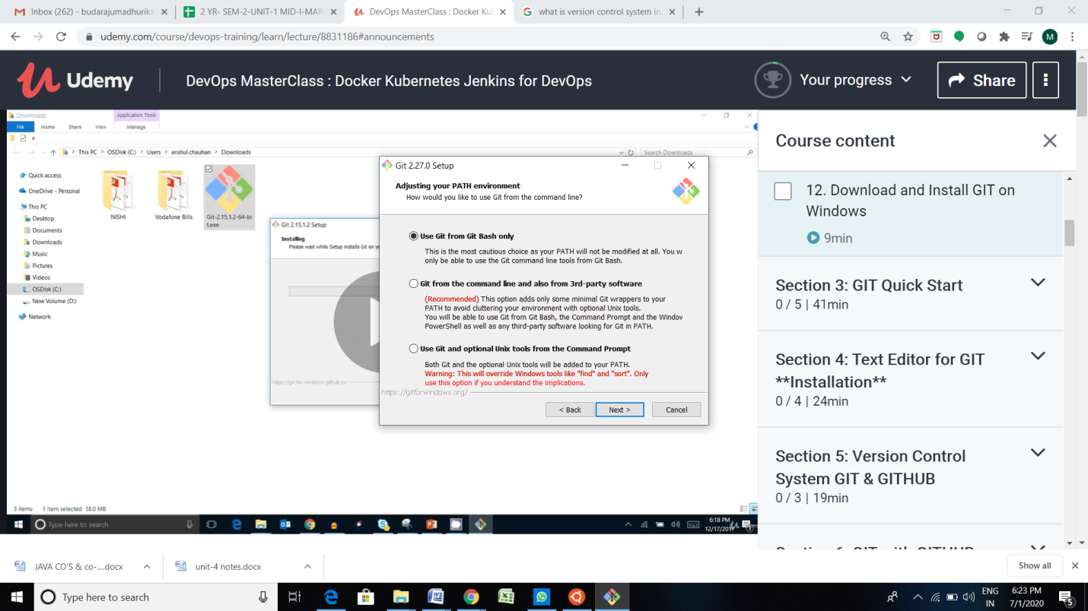
INSTALLING GIT IN WINDOWS
While installing select the option Use Git from Git Bash only option and click Next.

Slide 10
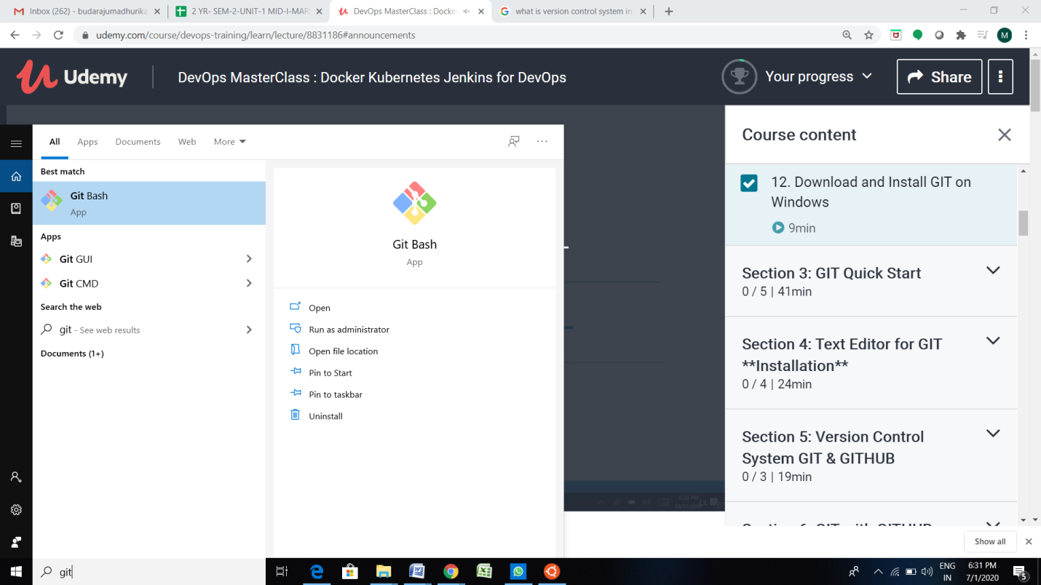
INSTALLING GIT IN WINDOWS
In the start, you will now find the Git Bash after successful installation.

Slide 11
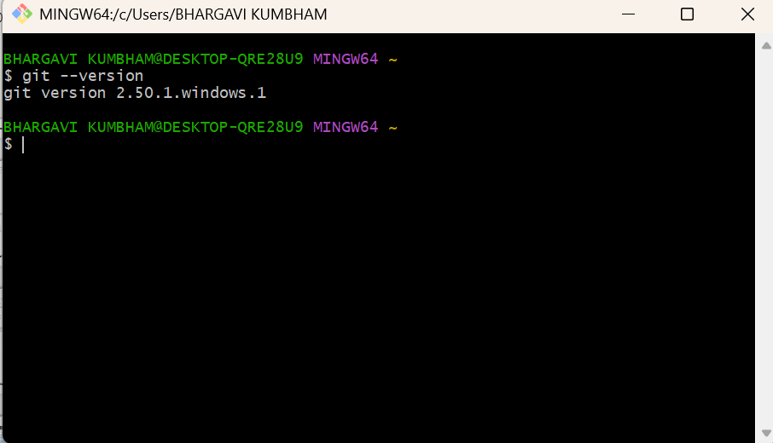
INSTALLING GIT IN WINDOWS
Follow this command to know the version of Git.

Slide 12
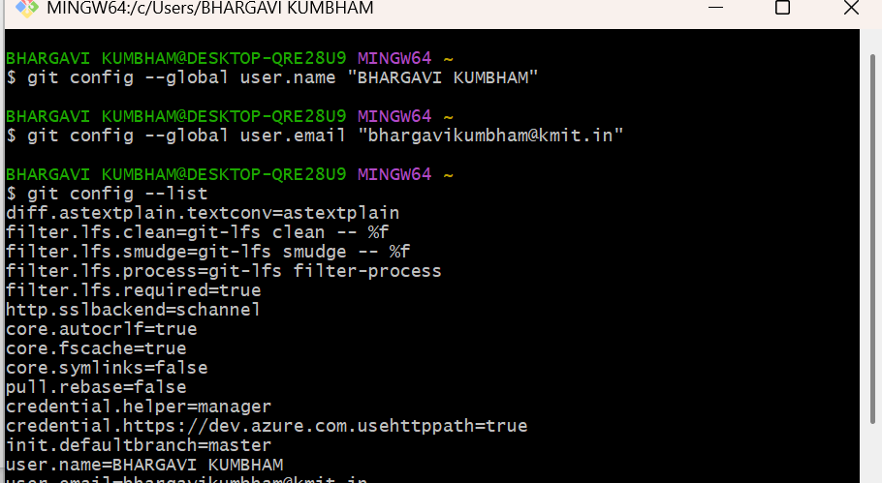
INSTALLING GIT IN WINDOWS
WE CAN CONFIGURE OUR NAME AND EMAIL IN GIT,
In personal computer it is not required to configure but in corporate company we have to configure user information in GIT as we will have random value in the user name as GIT will be installed in several machines and it will be using the machine ID, we will not be able to understand who has performed changes with random id, so better configure.

Slide 13
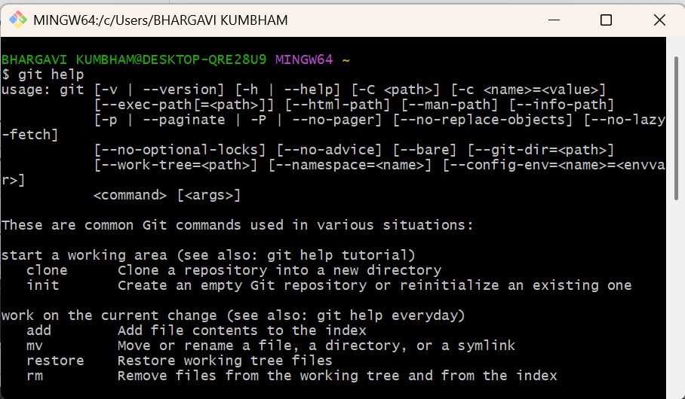
INSTALLING GIT IN WINDOWS
If we want to know the various commands in GIT, type git help

Slide 14
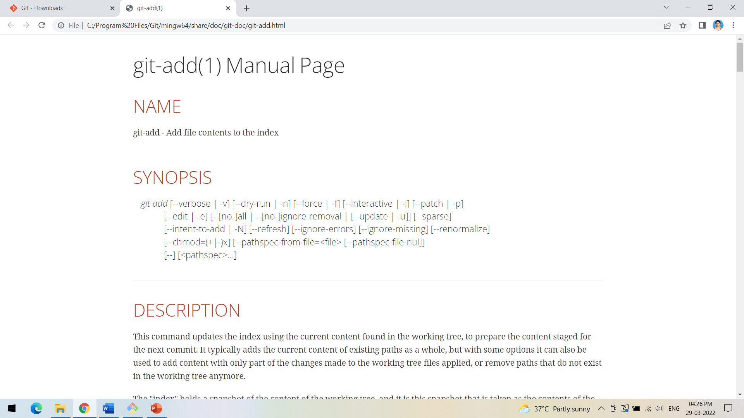
INSTALLING GIT IN WINDOWS
To know in detail about any command type git help command_name e.g. git help add

Slide 15
MAVEN INSTALLATION
Installation and Path Setting

Slide 16
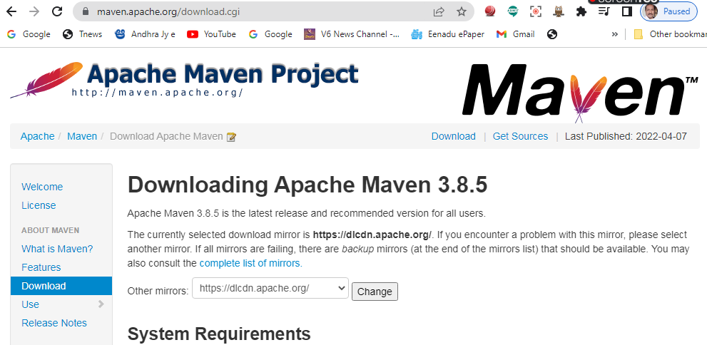
MAVEN INSTALLATION
Step 1: check whether maven is present in your system or not
Step 2: go to Google type download maven and click on download Apache maven

Slide 17
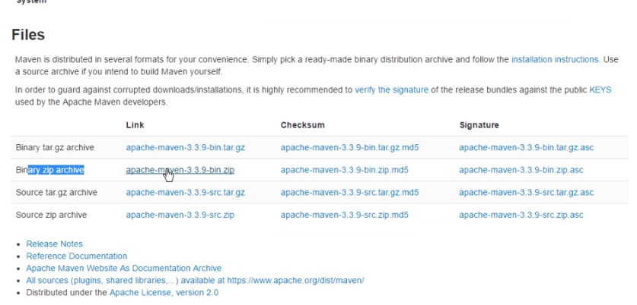
Step 3: click on apache-maven-3.3.9-bin zip

Slide 18
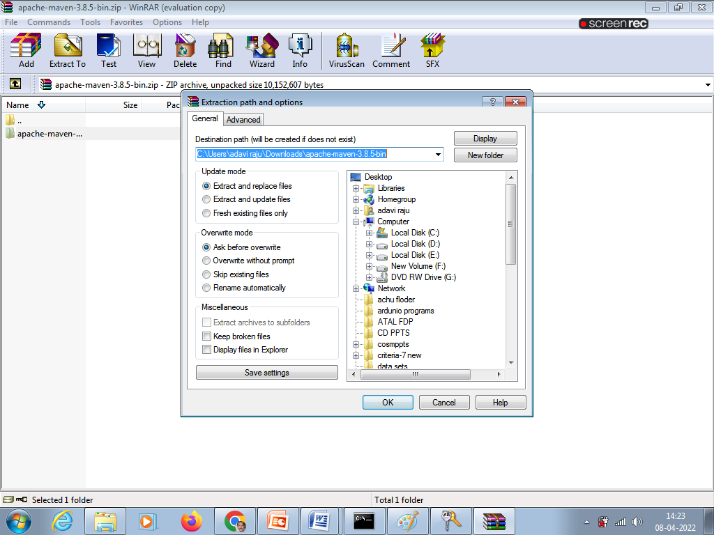
STEP 4: EXTRACT ZIP FILE

Slide 19
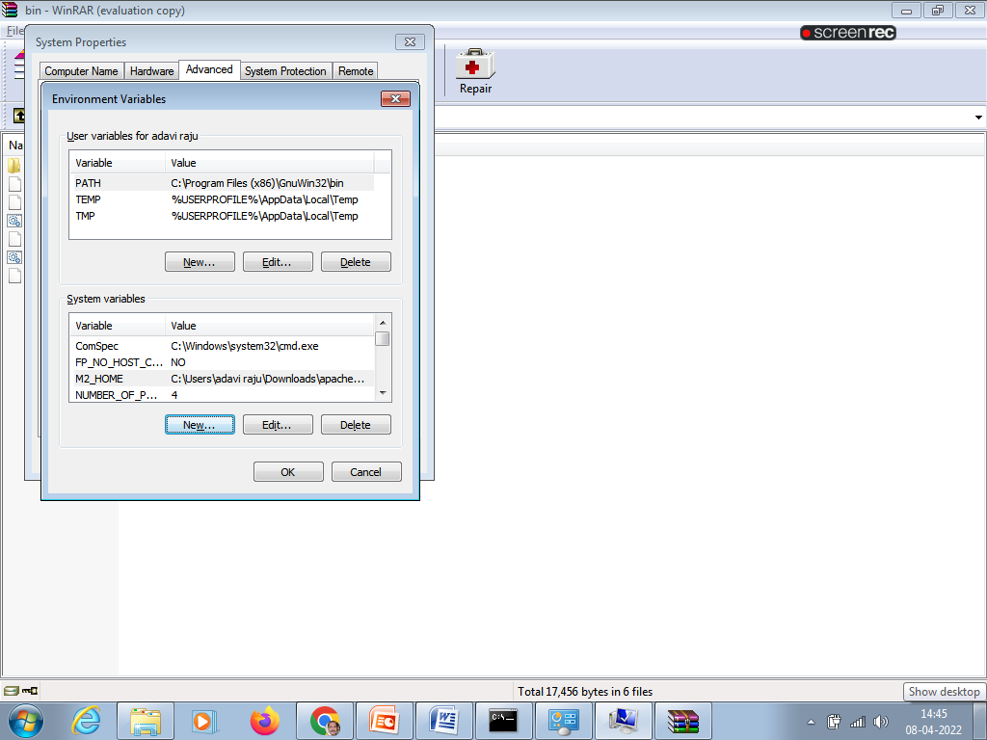
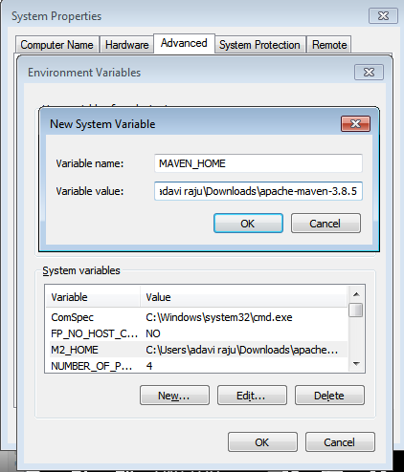
STEP 5: SET ENVIRONMENT VARIABLES

Slide 20
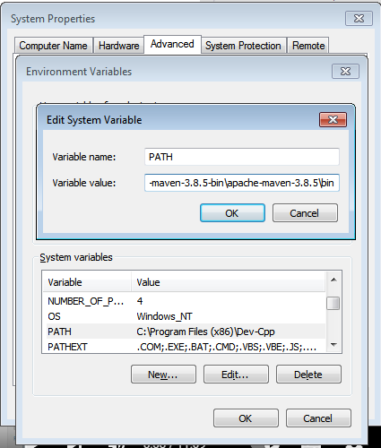
EDIT PATH

Slide 21
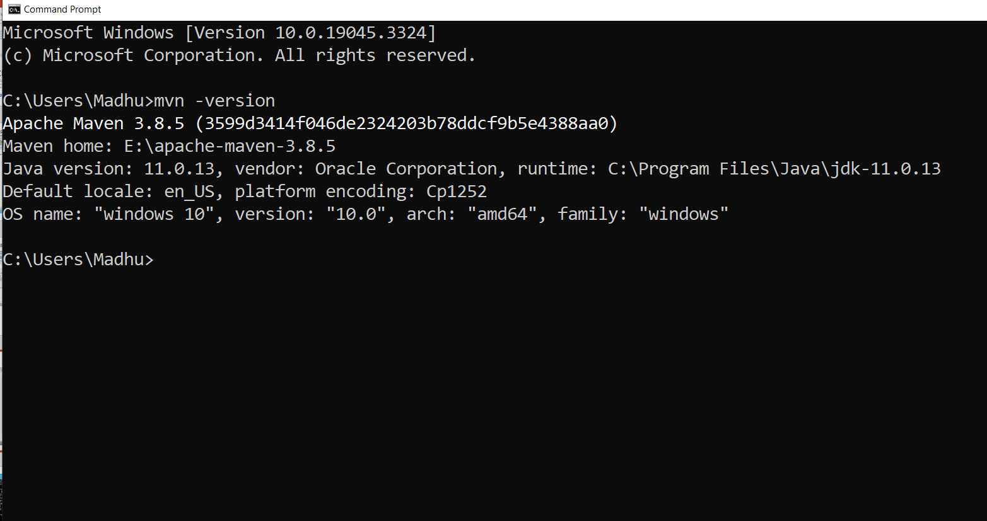

Slide 22
ECLIPSE UPDATES INSTALLATION
Before configuring Tomcat to Eclipse

Slide 23
ECLIPSE UPDATES INSTALLATION
Before configuring Tomcat to Eclipse

Slide 24
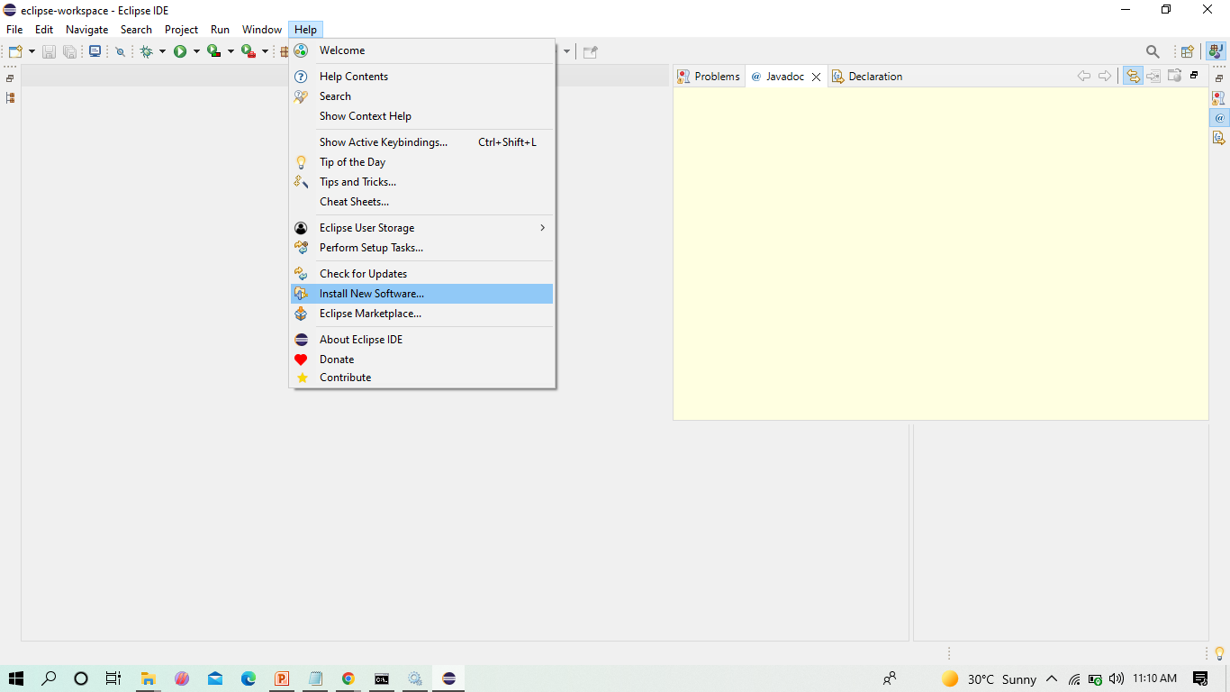
INSTALL UPDATES INTO ECLIPSE

Slide 25
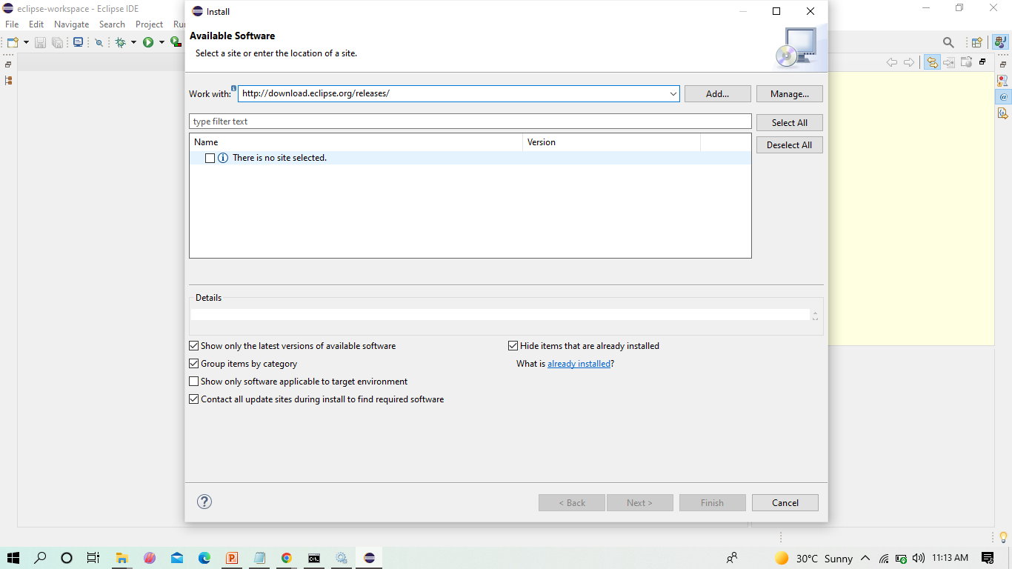
BEFORE INSTALLING SERVER INTO ECLIPSE, WE NEED TO ADD JAVA EE TO THE ECLIPSE IDE

Slide 26
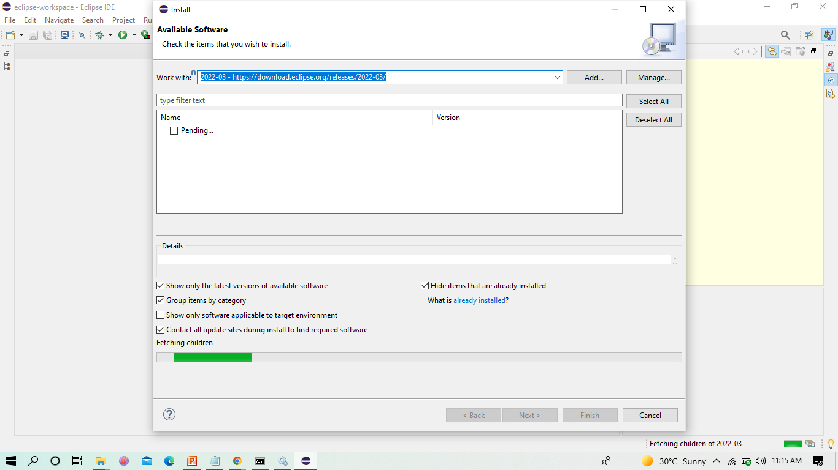
CLICK ON THE DROP DOWN MENU IN WORK WITH AND SELECT THE FOLLOWING FROM THE LIST

Slide 27
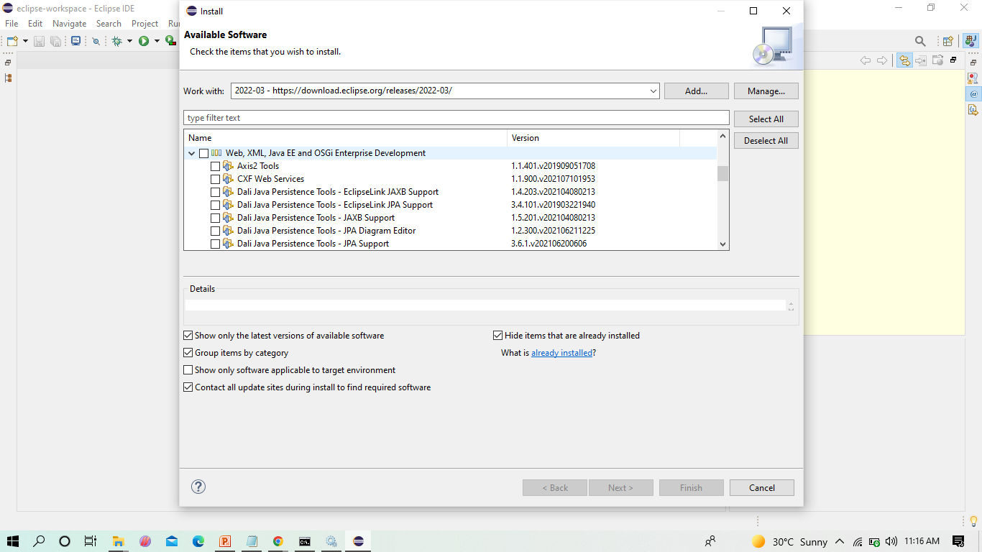
CHECK THE WEB,XML,JAVA EE BOX TO INSTALL THE LATEST SOFTWARE INTO ECLIPSE IN ORDER TO EXECUTE THE DYNAMIC WEB PROJECTS, MAVEN WEB PROJECTS. ETC.

Slide 28
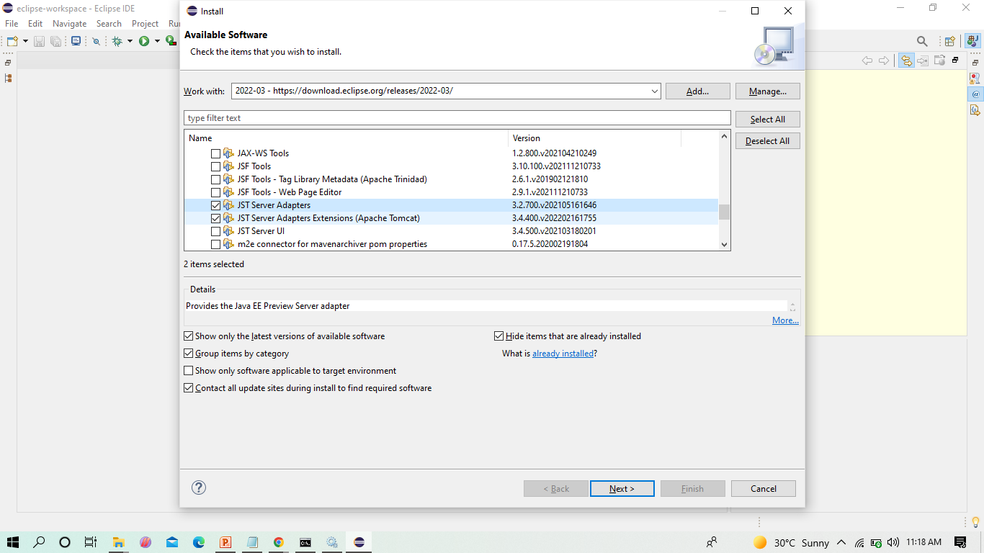
SINCE WE DEVELOP ONLY MAVEN WEB PROJECT IN DEVOPS, WE CAN ONLY CHECK THE SHOWN TWO AND CLICK ON NEXT

Slide 29
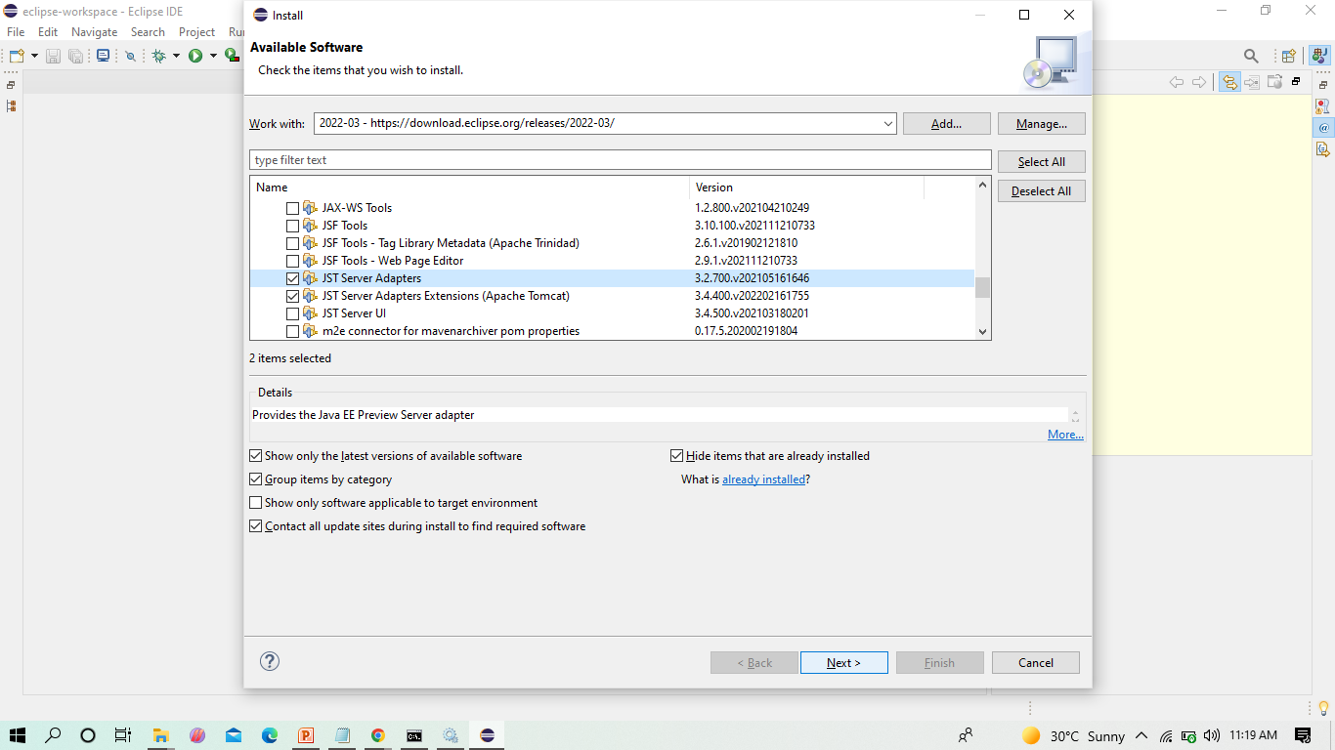
HERE ENABLE THE JST ADAPTER AND JST SERVER ADAPTER

Slide 30
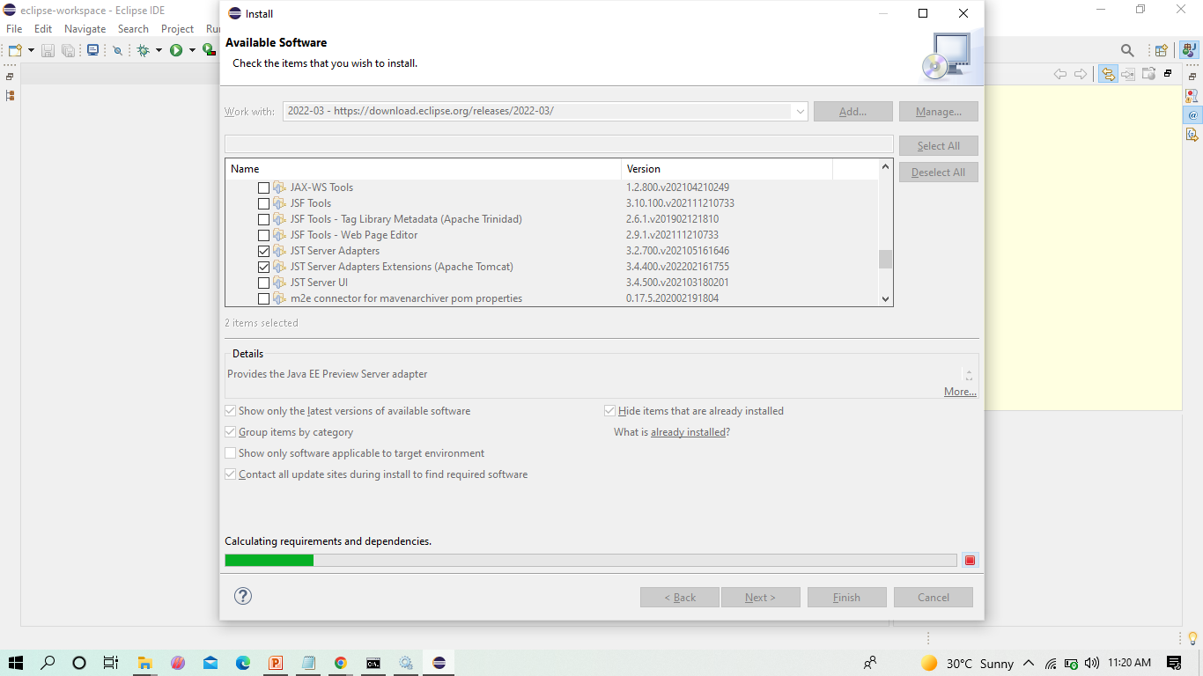
INSTALL THEM

Slide 31
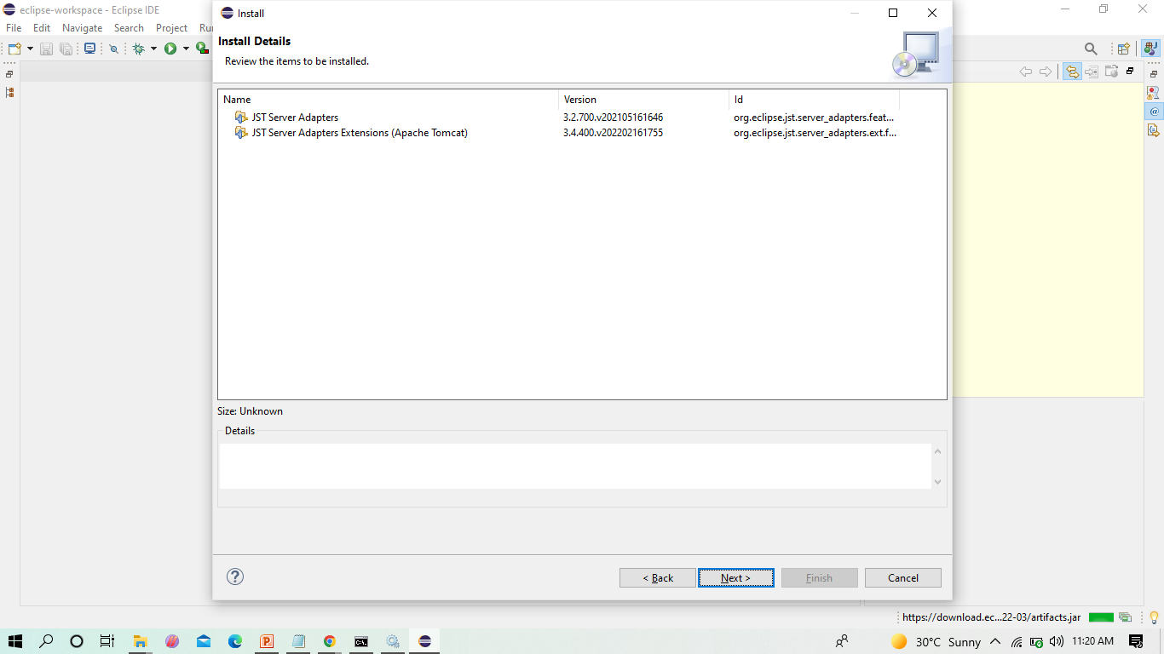
CLICK ON -> NEXT

Slide 32
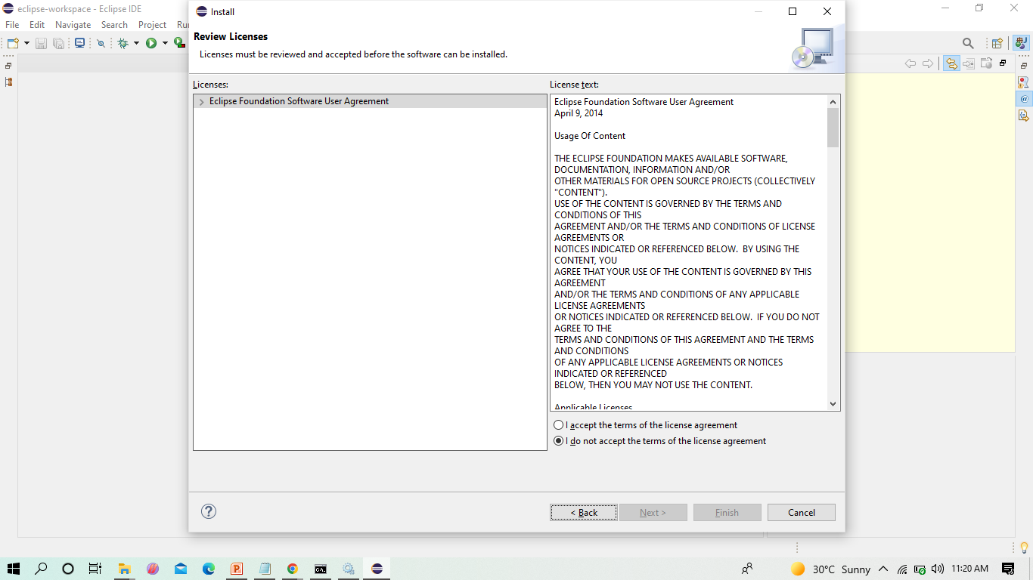
SELECT ON -> I AGREE

Slide 33
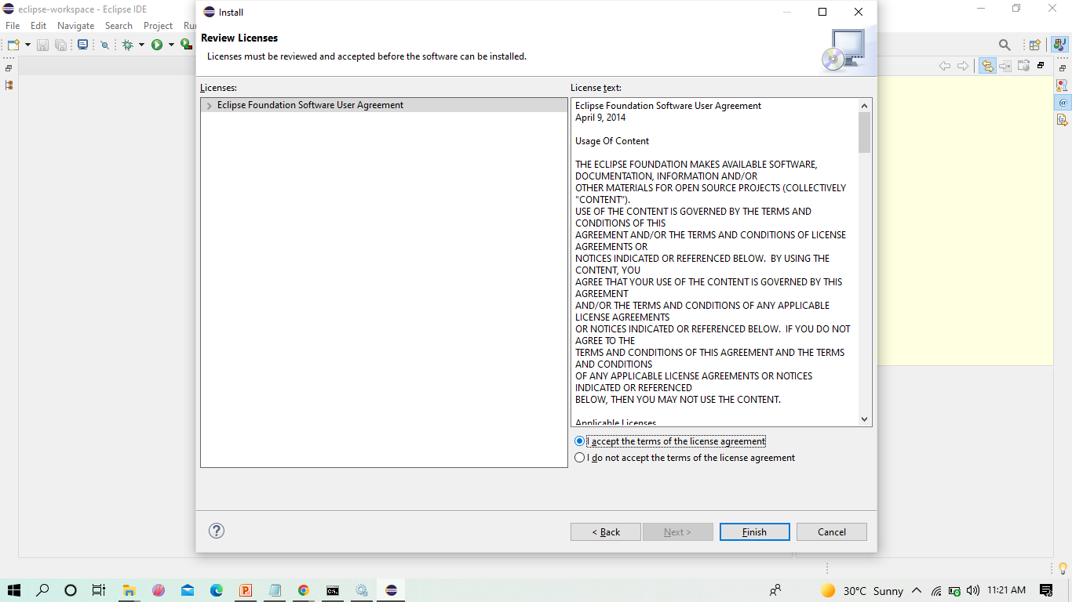
Select on -> I accept -> Finish

Slide 34
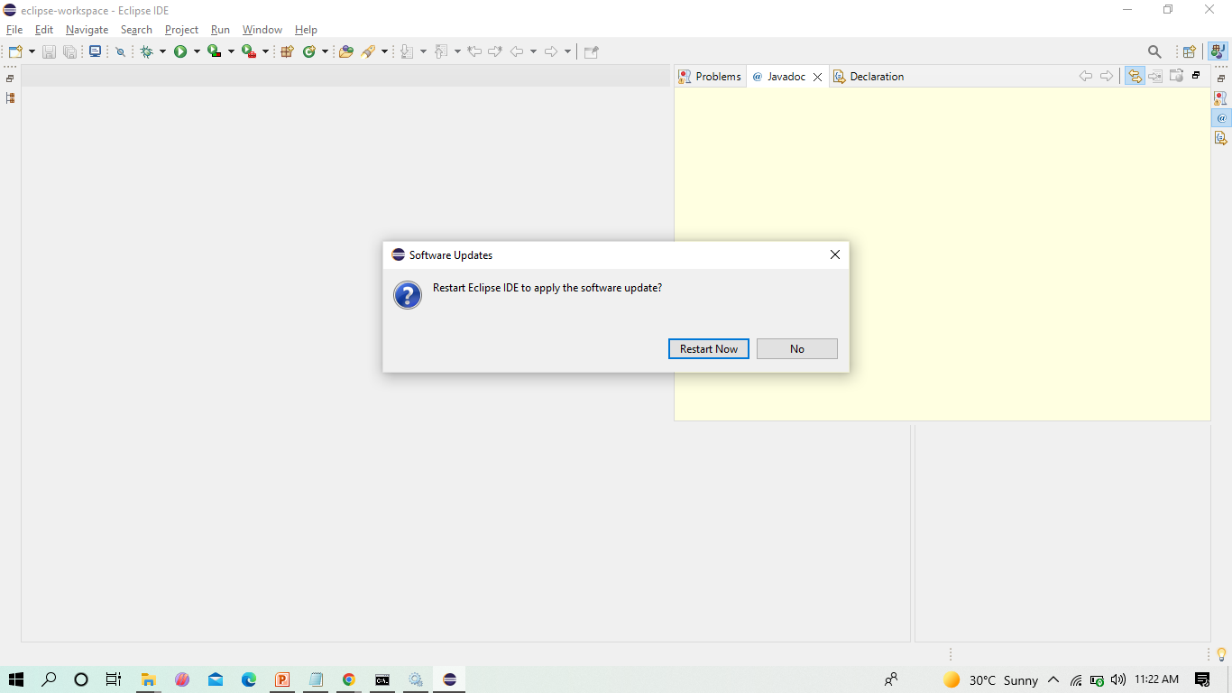
RESTART THE ECLIPSE IDE

Slide 35
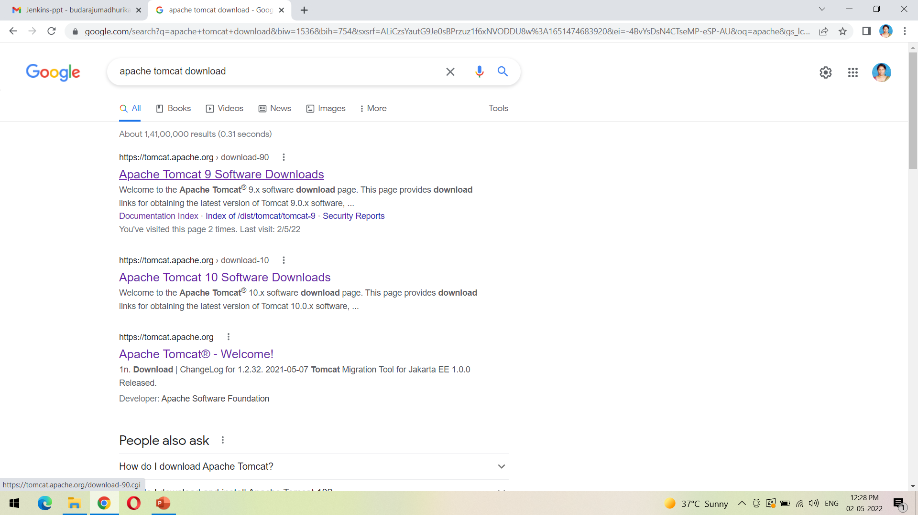
DOWNLOAD THE TOMCAT FROM THE FIRST LINK AS SHOWN

Slide 36
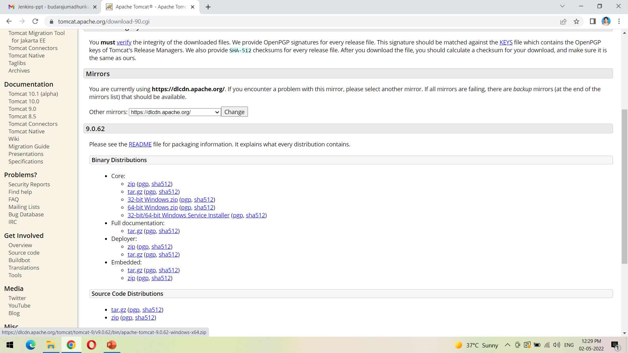
CLICK ON THE FOLLOWING LINK 64-BIT WINDOWS ZIP TO DOWNLOAD THE ZIP FILE

Slide 37
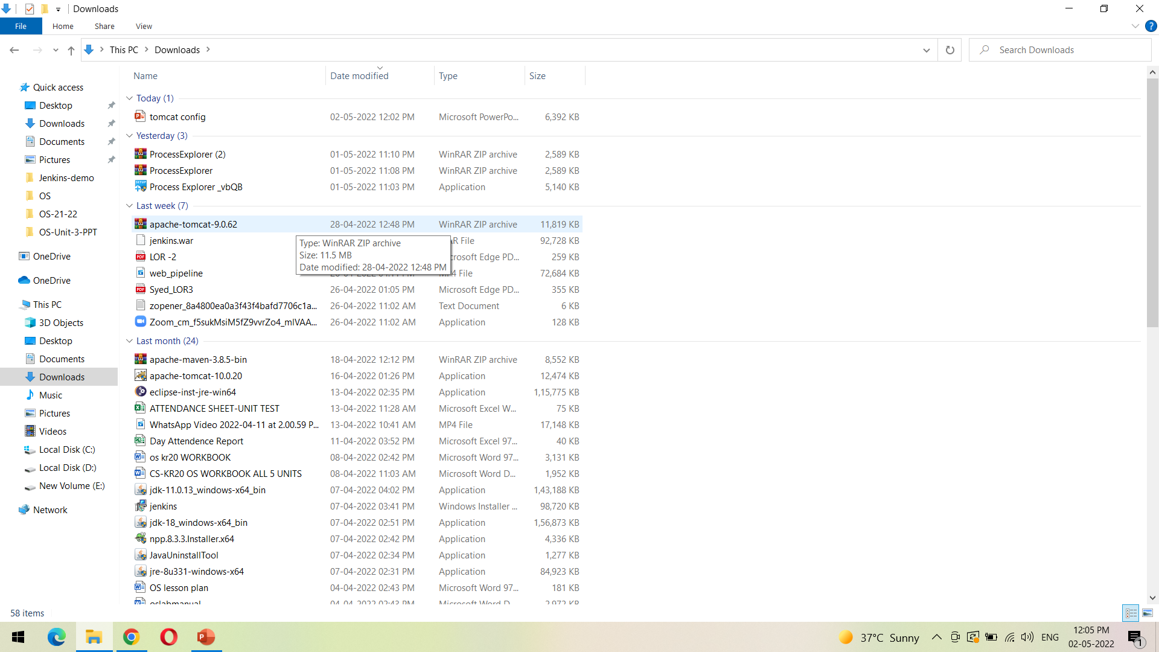
WE CAN VIEW THE DOWNLOADED FILE FROM DOWNLOADS FOLDER AS SHOWN

Slide 38
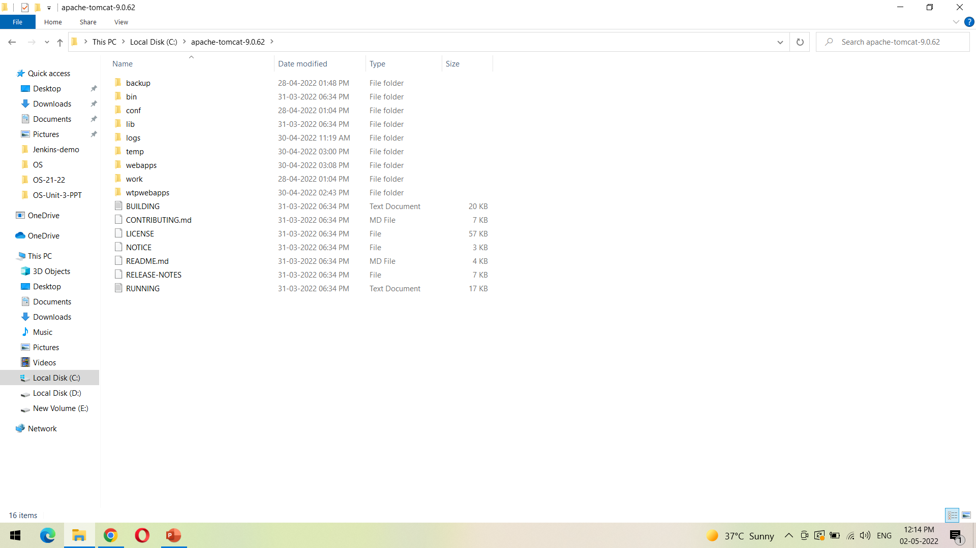
Unzip the downloaded file into the path shown

Slide 39
TO INSTALL TOMCAT SERVER INTO ECLIPSE

Slide 40
BEFORE INSTALLING SERVER INTO ECLIPSE, WE NEED TO ADD JAVA EE TO THE ECLIPSE IDE

Slide 41
CLICK ON THE DROP DOWN MENU IN WORK WITH AND SELECT THE FOLLOWING FROM THE LIST

Slide 42
CHECK THE WEB,XML,JAVA EE BOX TO INSTALL THE LATEST SOFTWARE INTO ECLIPSE IN ORDER TO EXECUTE THE DYNAMIC WEB PROJECTS, MAVEN WEB PROJECTS. ETC.

Slide 43
SINCE WE DEVELOP ONLY MAVEN WEB PROJECT IN DEVOPS, WE CAN ONLY CHECK THE SHOWN TWO AND CLICK ON NEXT

Slide 44
HERE ENABLE THE JST ADAPTER AND JST SERVER ADAPTER

Slide 45
INSTALL THEM

Slide 46
CLICK ON -> NEXT

Slide 47
SELECT ON -> I AGREE

Slide 48
Select on -> I accept -> Finish

Slide 49
RESTART THE ECLIPSE IDE

Slide 50
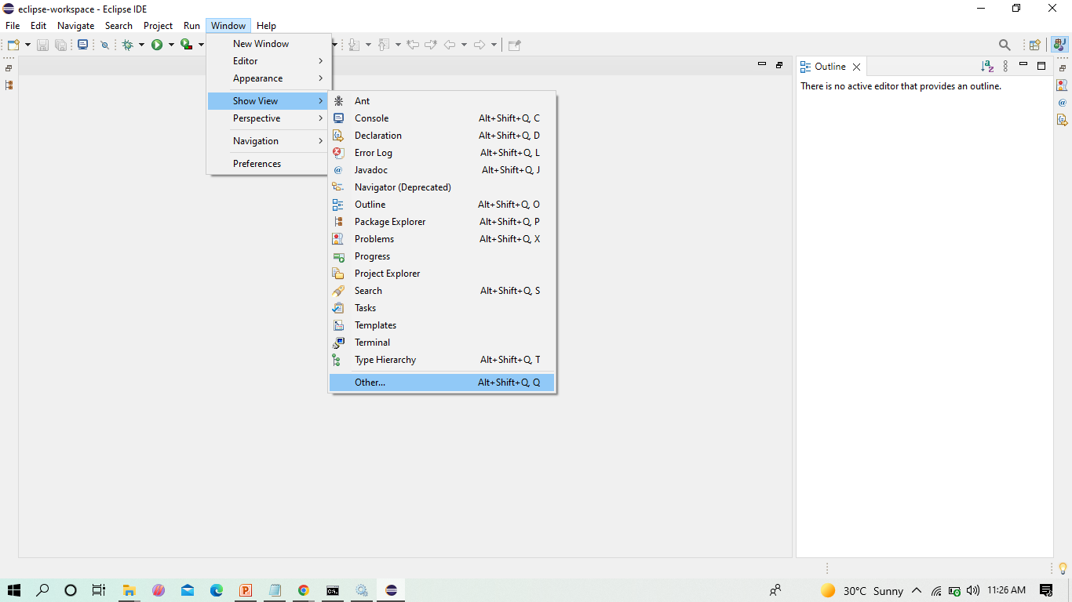
AFTER THE SHOWN INSTALLATION, CHECK WHETHER SERVER IS AVAILABLE IN ECLIPSE AS SHOWN

Slide 51
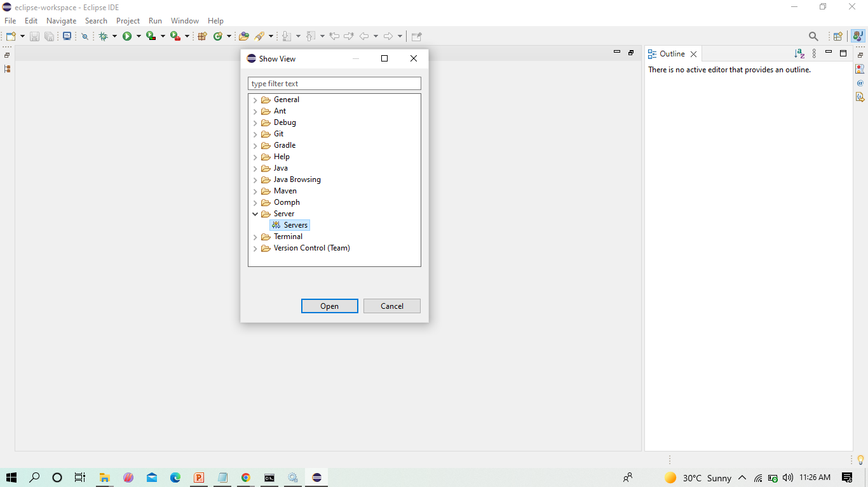
IN SHOW VIEW, WE CAN NOW SEE SERVERS

Slide 52
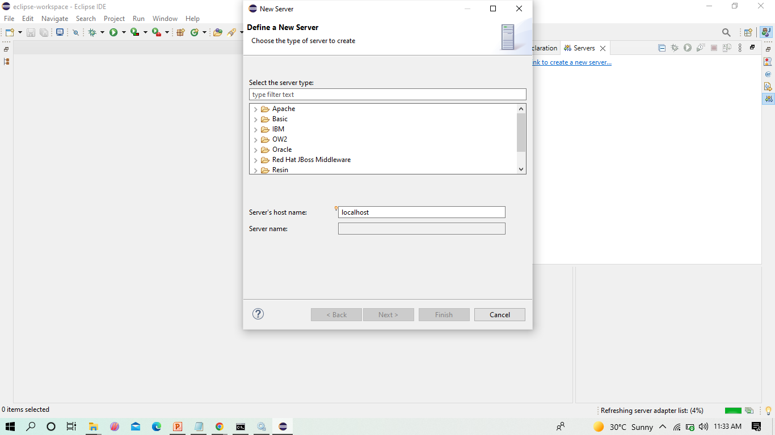
CLICK ON APACHE FOLDER

Slide 53
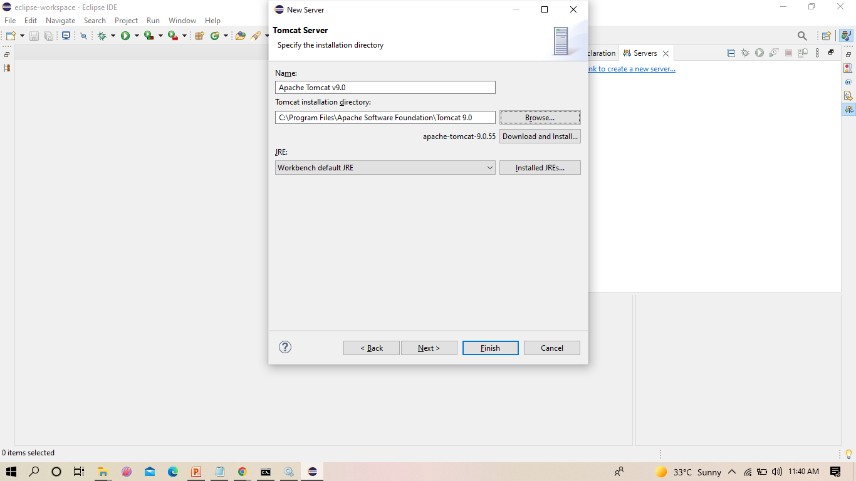
BROWSE THE TOMCAT FOLDER AVAILABLE IN YOUR LOCAL SYSTEM AS SHOWN

Slide 54
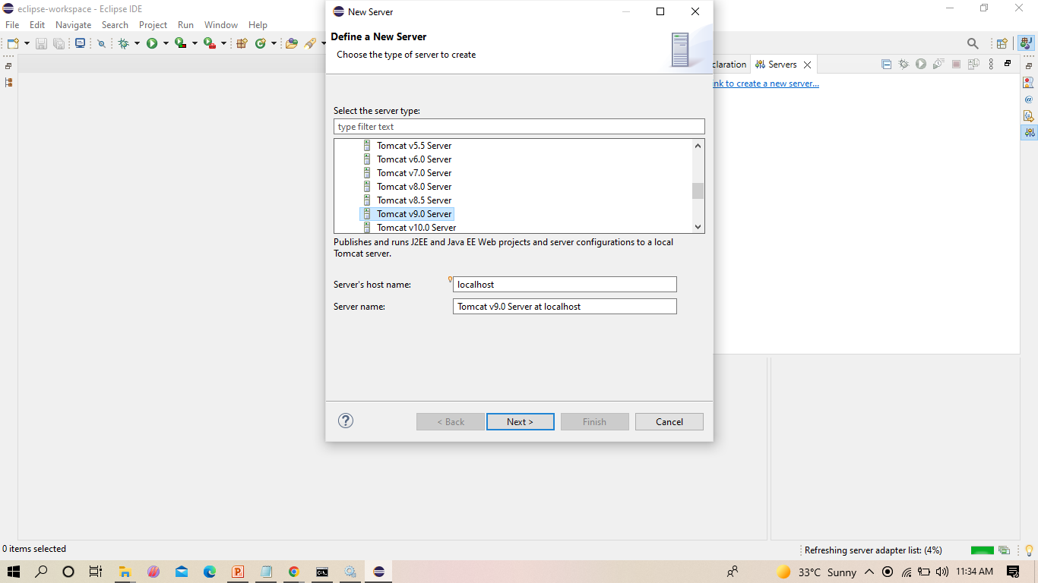
SELECT TOMCAT V 9 AS SHOWN

Slide 55
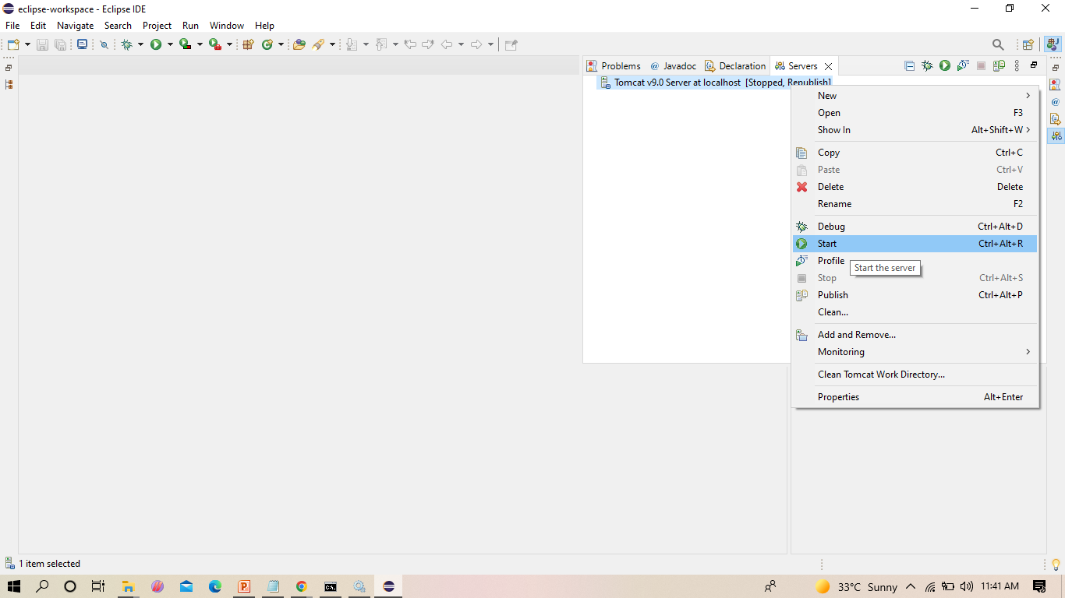
FROM NOW ON WE CAN START TOMCAT SERVER FROM ECLIPSE IDE AS SHOWN

Slide 56
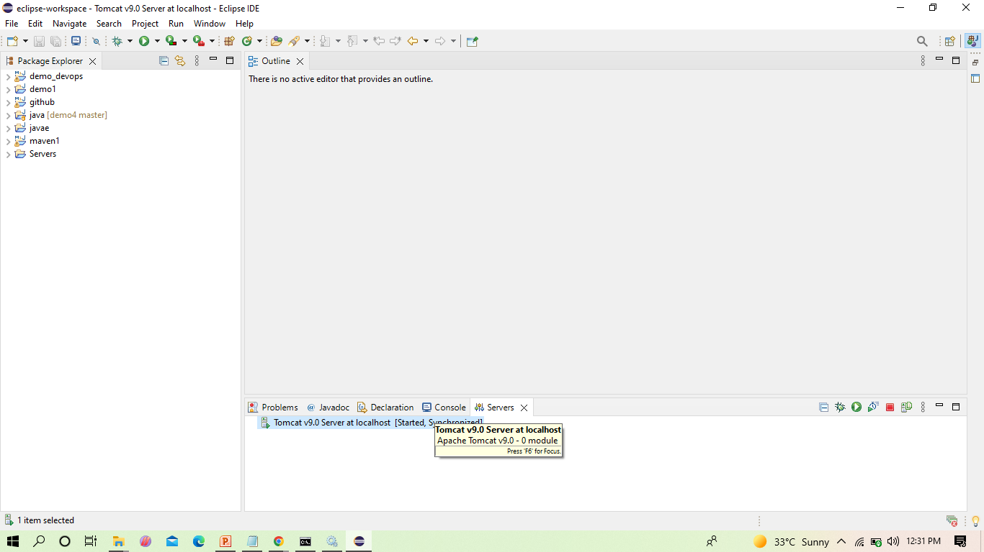
WE CAN NOW SEE THAT THE SERVER IS STARTED
Double click on it

Slide 57
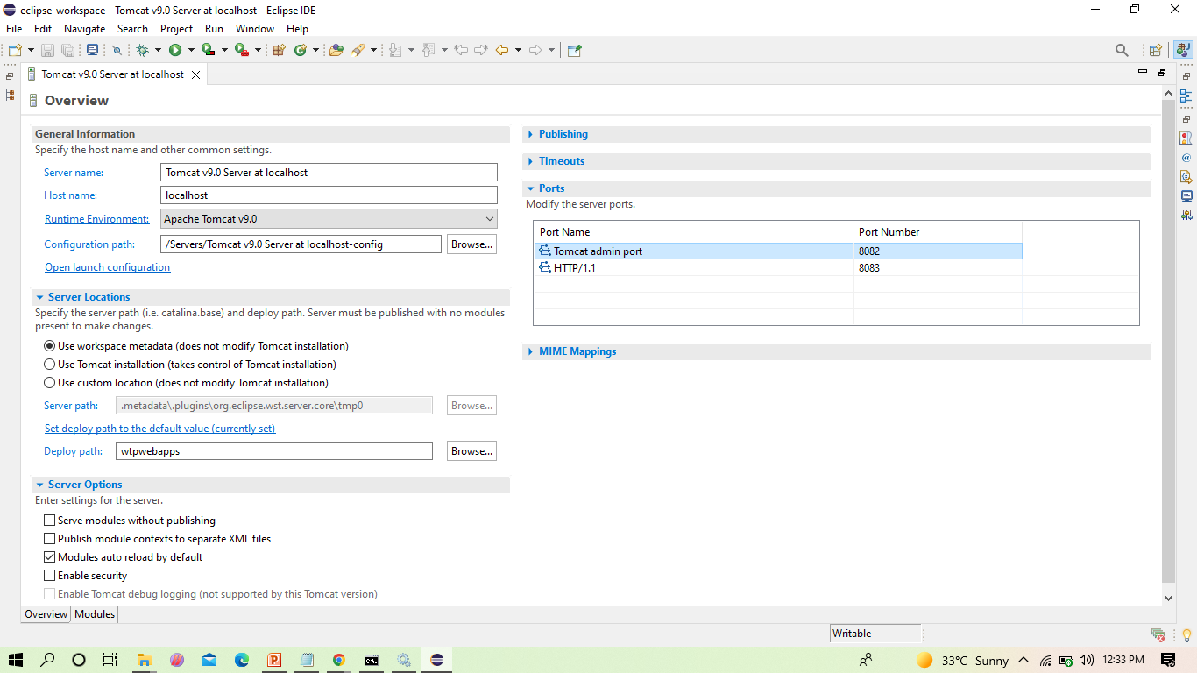
THE NEXT STEP IS TO CHANGE THE PORT NUMBER OF THE TOMCAT AS JENKINS USES 8080, AS SHOWN

Slide 58
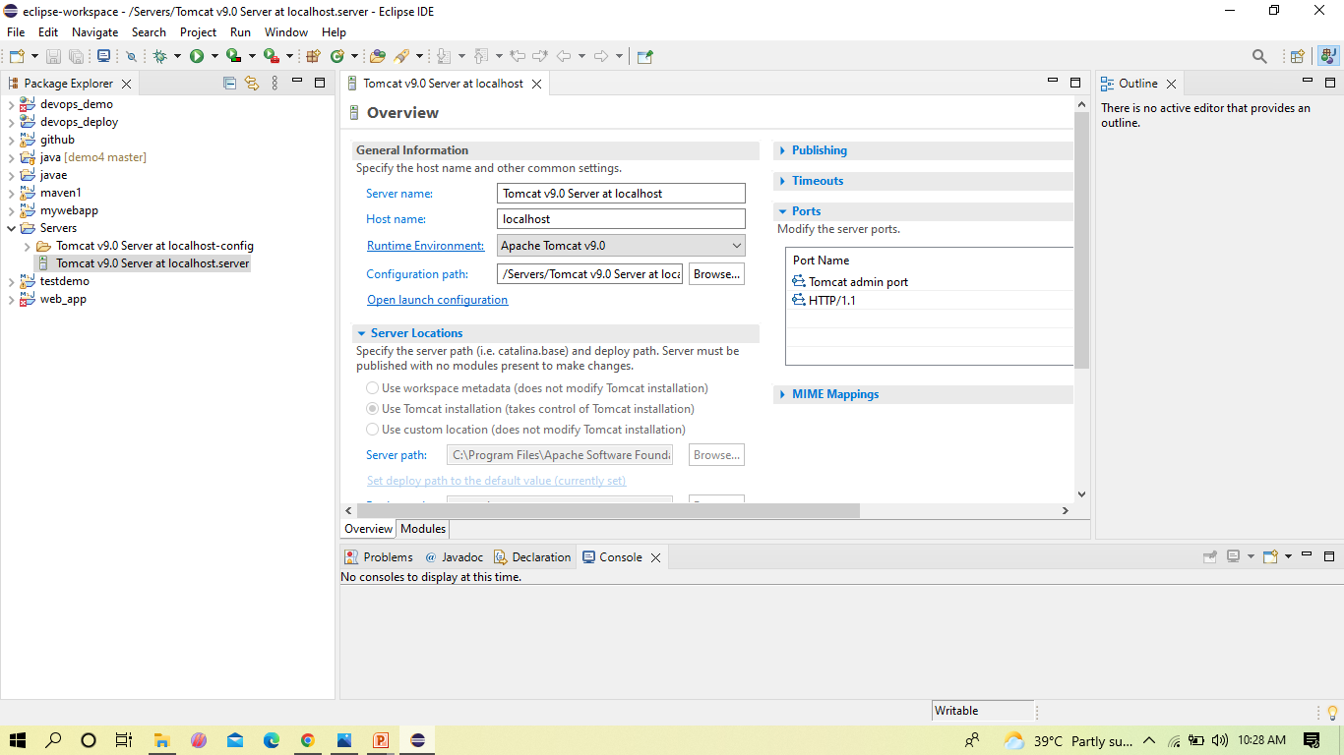
IN SERVER LOCATIONS MAKE SURE SECOND OPTION IS SELECTED

Slide 59
Copy the following text in the location shown in the below slides
<role rolename="admin-gui,manager-gui ,manager-script,manager-jmx,manager-status"/>
<user username=“admin" password="1234"roles="manager-gui, admin-gui ,manager-script"/>

Slide 60
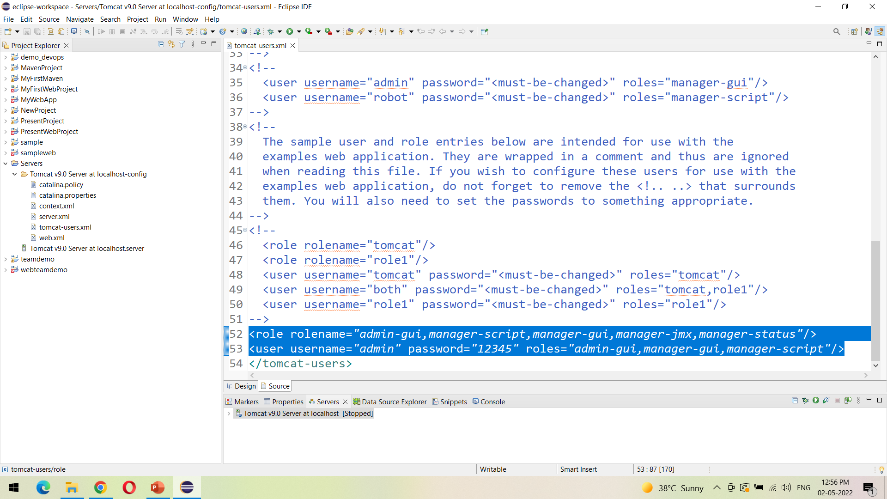
Open the tomcat-users.xml file as show, and add the highlighted text in the last

Slide 61
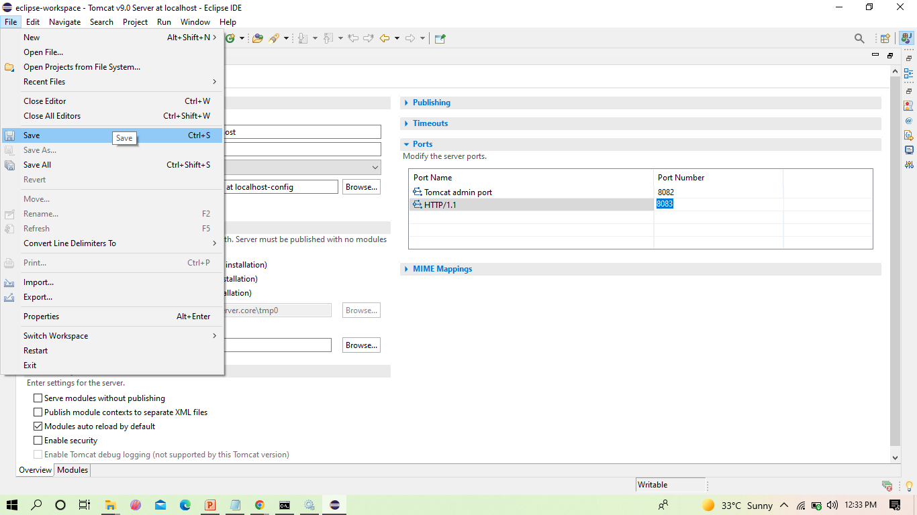
AFTER THE CHANGES, CLICK ON SAVE

Slide 62
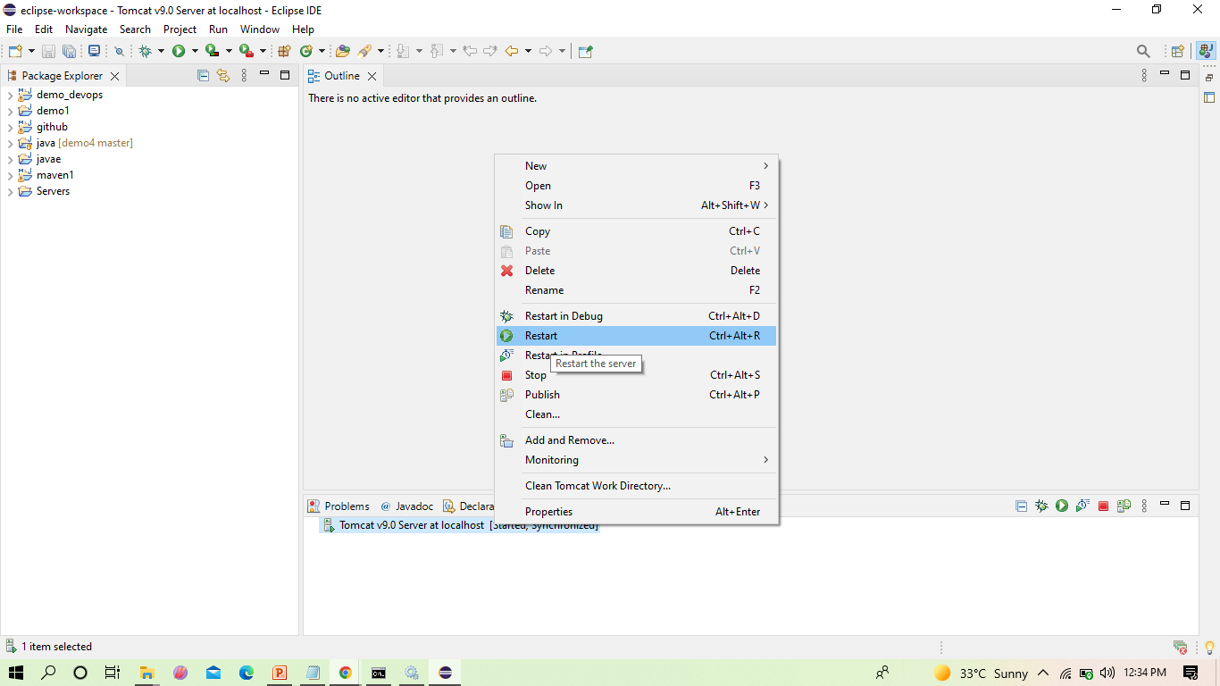
NOW RESTART THE SERVER

Slide 63
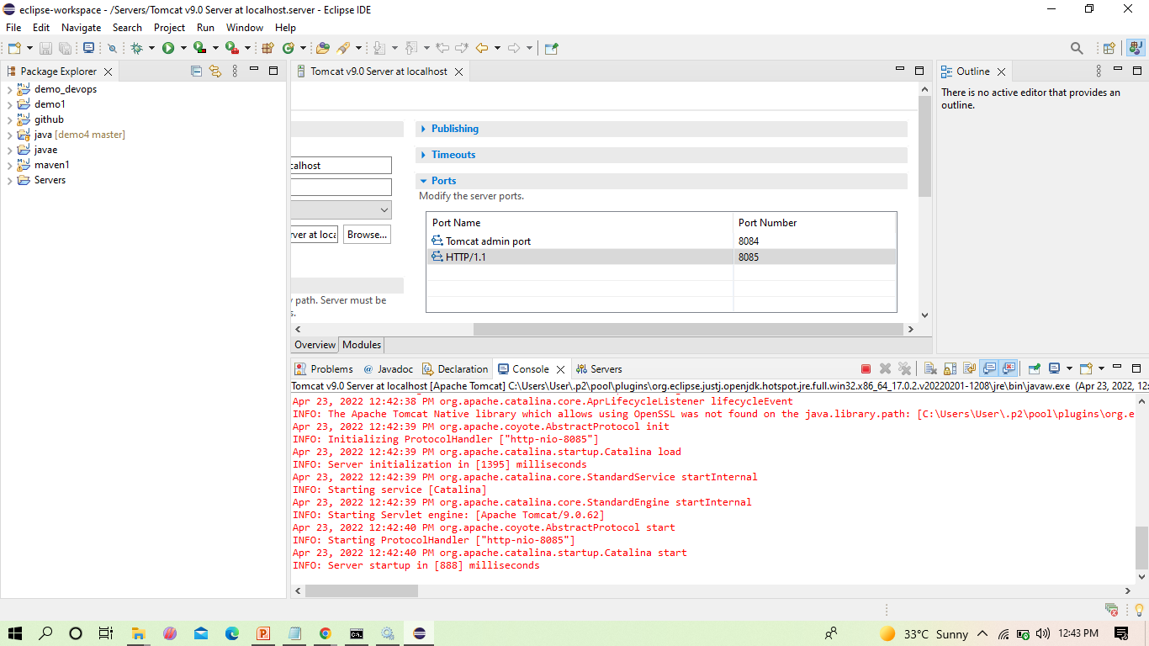
THE SERVER GETS RESTARTED AS SHOWN

Slide 64
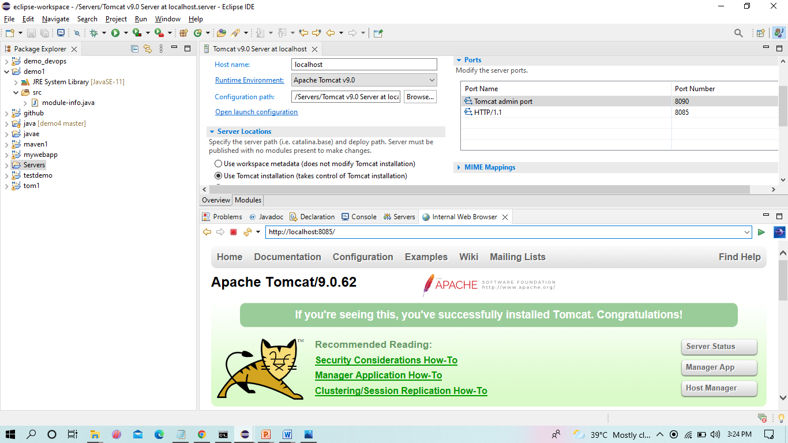
WE CAN SEE THE TOMCAT IS SUCCESSFULLY RUNNING ON THE NEW PORT NUMBER

